Slide 1
Object Detection using Convolution Neural Network
Overfeat

Slide 2

Overfeat
Idea 4
Sliding window (spatial output) + Pretrained Model + Image Pyramid + FC as Convnet
Train Localize multi class classification model
Use it as pretrained model for object detection task
Sliding window
Image Pyramid
FC as convnet
NMS
- To understand generalize property of Bbox
- Multi class detection
- To detect multiple instance of object
- For detecting varying size object
- To overcome CNN constrain
- For final prediction
Overfeat Paper

Slide 3
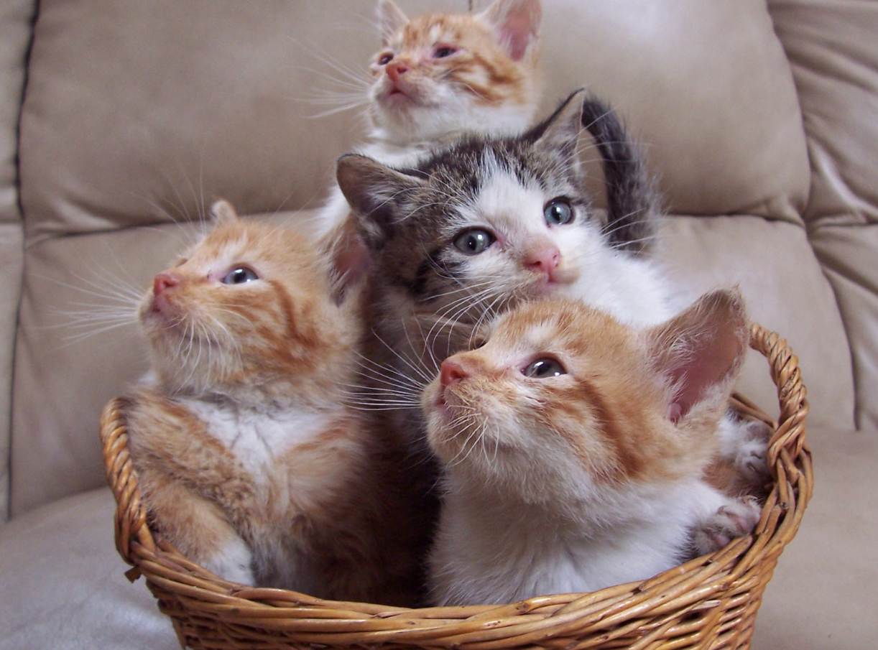
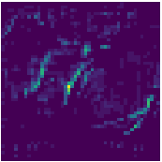
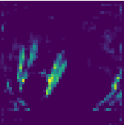
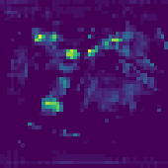
Overfeat
Idea 4
Sliding window (spatial output ) + Pretrained Model + Image Pyramid + FC as convnet
Testing
FC as convnet
FC1
Regression
MODEL
FC2
VGG 16
Sliding window
+
Image Pyramid
Feature Extraction
Classification
Pre Trained Localize Model

Slide 4
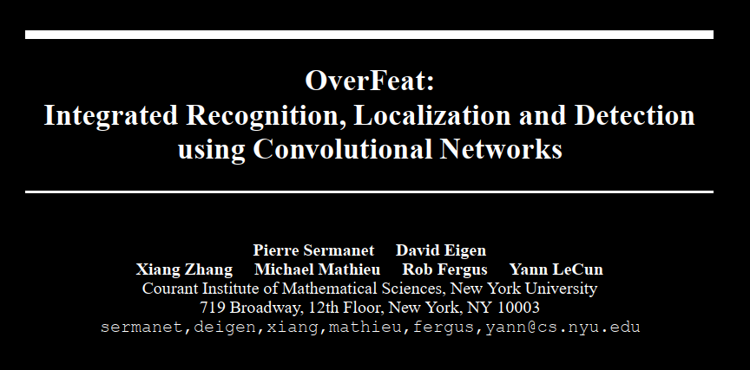
Overfeat - Experiment
~ winner of the localization task of the ImageNet Large Scale Visual Recognition Challenge 2013 (ILSVRC2013)
Paper link: https://arxiv.org/abs/1312.6229

Slide 5

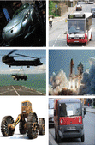
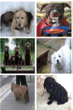
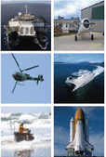
Overfeat - Experiment - Classification and Localization - Training
2012
ImageNet 2012 dataset
1000 classes
Trained classification and localization task on modified AlexNET.
ILSVRC 2013 1st Winner for classification and localization task
3rd Rank for Detection task
Vehicle
Dog
Craft
1000 classes

Slide 6
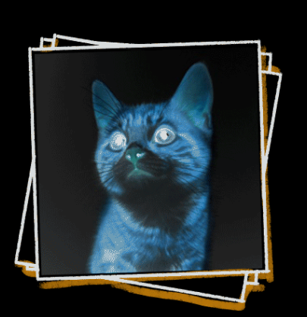
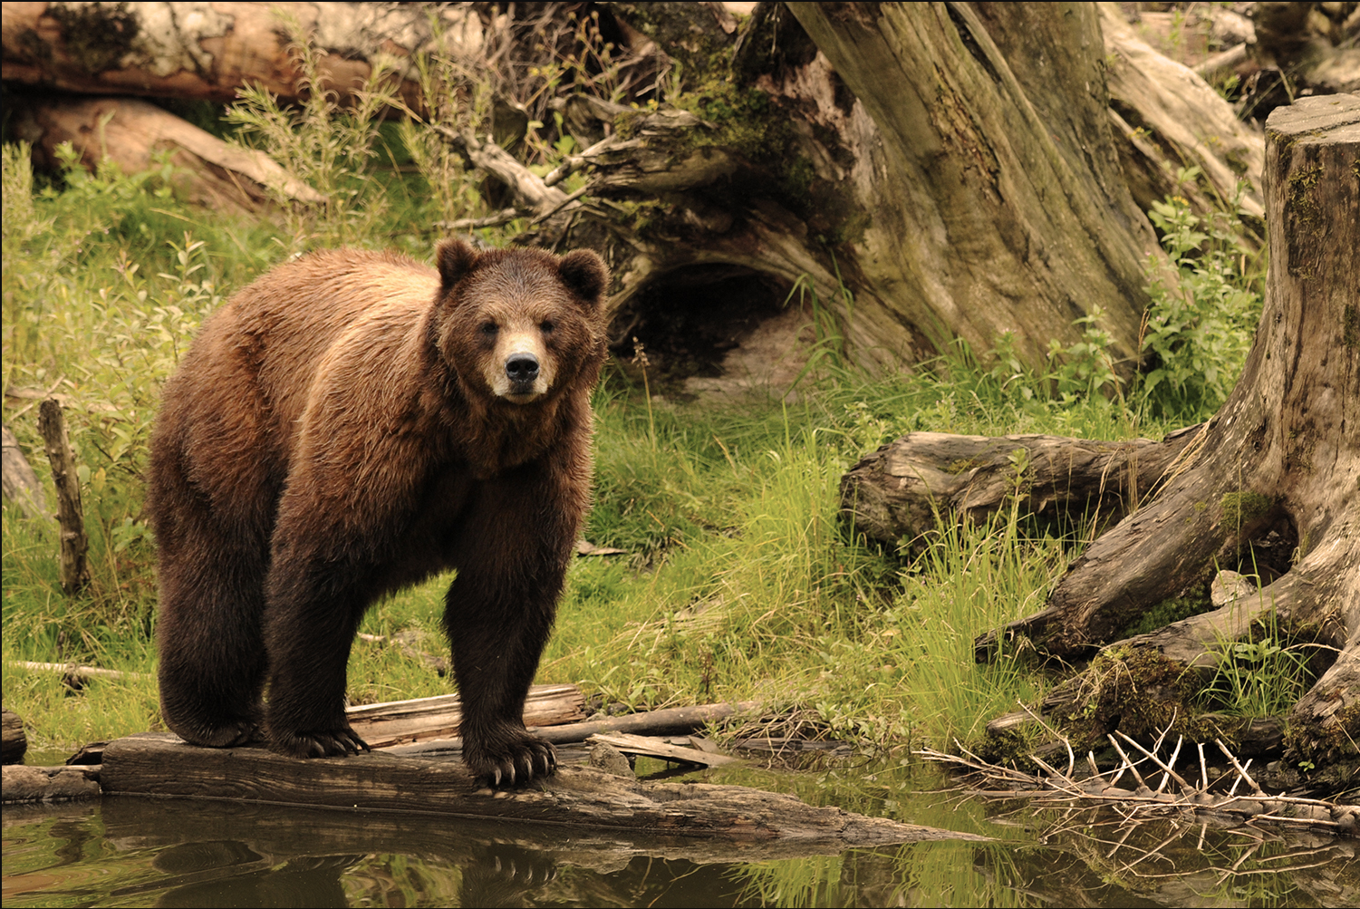
Overfeat - Experiment - Classification and Localization - Training
Classification and Localization
Localize Bounding Box
ImageNet 2012 Dataset – 1000 CLASS
Regression
FC1
MODEL
FC2
Feature Extraction
Image + Bounding Box
Classification
Classify Class k
Modified AlexNET
ILSVRC 2013 1st Winner for classification and localization task

Slide 7
Overfeat - Experiment - Object Detection - Training
Training without Background class leads to a lot of False Positive prediction.
To avoid FP, one additional class is used.
Training data for background is taken randomly where no object is present.
Training of Classification and Localization is done on 20 + 1 Class.
Base dimension for training is 245 x 245
245 x 245
Classification and Localization
Regression
MODEL
Training
C + 1 Class
+ 1 for Background
Classification

Slide 8
Overfeat - Experiment - Object Detection - Inference
Pretrained Classification and Localization Network trained on C + 1 Class
Spatial output of Image pyramid with base dimension of prediction is 245 x 245
6 Scale Image pyramid with 1:2 factor of Resolution
FC as Convent
Resolution / Subsampling ratio / Effective Strides = 36

Slide 9
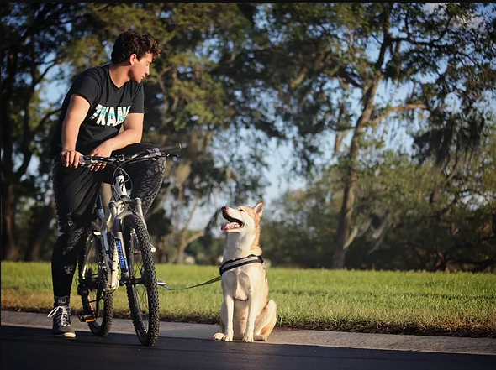
Overfeat - Experiment - Resolution
Resolution / Subsampling Ratio / Effective Stride = 36
Resolution / Subsampling Ratio / Effective Stride = 18
389 x 461
317 x 386
317 x 386
Spatial Output
For 1 class only
3 x 5
6 x 10
5 x 7

Slide 10
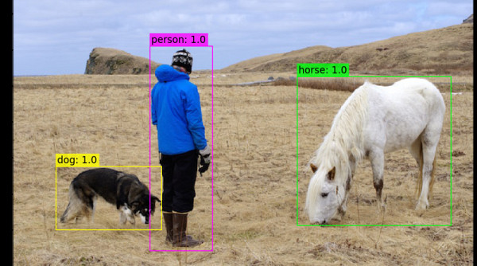
Overfeat - Experiment - Image Pyramid - Spatial Output
6 Scale Image Pyramid with 1:2 factor of Resolution
281 x 317
317 x 386
389 x 461
425 x 497
464 x 569
2 x 3 x C+1
3 x 5 x C+1
5 x 7 x C+1
6 x 7 x C+1
7 x 10 x C+1
1 x 1 x C+1
Resolution / Effective Stride = 36
245 X 245
Credit: https://www.youtube.com/watch?v=9I6nzfx_kpE&list=PL1GQaVhO4f_jLxOokW7CS5kY_J1t1T17S&ab_channel=Cogneethi

Slide 11
Overfeat - Experiment - Object Detection - Inference
Spatial Output
2 x 3
+
3 x 5
+
5 x 7
+
6 x 7
+
7 x 10
= 169 x C+1
Resolution / Effective Stride = 36
NMS
245 X 245
245 X 245

Slide 12
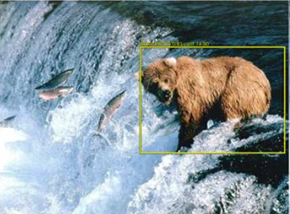
Overfeat - Experiment - Object Detection - Inference
1 x 1 x 4 x c+1
245 X 245
2 x 3 x 4 x c+1
Localize Bounding Box
3 x 5 x 4 x c+1
281 x 317
Regression
5 x 7 x 4 x c+1
Classification and Localization
317 x 386
6 x 7 x 4 x c+1
Query
7 x 10 x 4 x c+1
MODEL
389 x 461
245 X 245
Modified Alex NET
1 x 1 x c+1
425 x 497
2 x 3 x c+1
Classification
3 x 5 x c+1
Classify
Class c+1
5 x 7 x c+1
464 x 569
6 x 7 x c+1
7 x 10 x c+1
Credit: https://www.youtube.com/watch?v=9I6nzfx_kpE&list=PL1GQaVhO4f_jLxOokW7CS5kY_J1t1T17S&ab_channel=Cogneethi

Slide 13
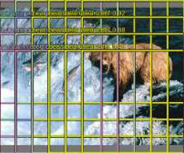
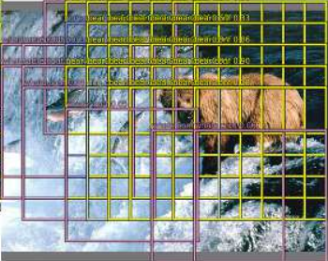
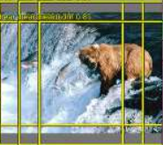

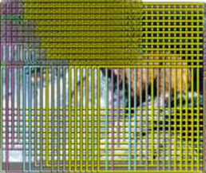
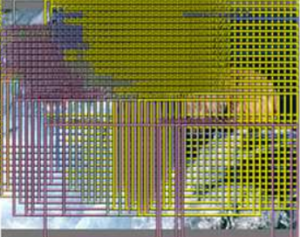
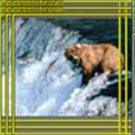
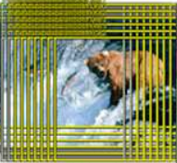
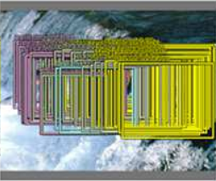
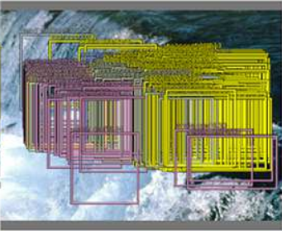
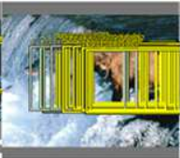
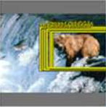
Query Input
Resolution = 36
Classification Confidence Box
Resolution = 12
Model
Regression Bounding Box
Credit: https://arxiv.org/abs/1312.6229

Slide 14
Overfeat - Experiment - Object Detection - Inference
NMS
Spatial Outputs
Final prediction
Credit: https://arxiv.org/abs/1312.6229

Slide 15
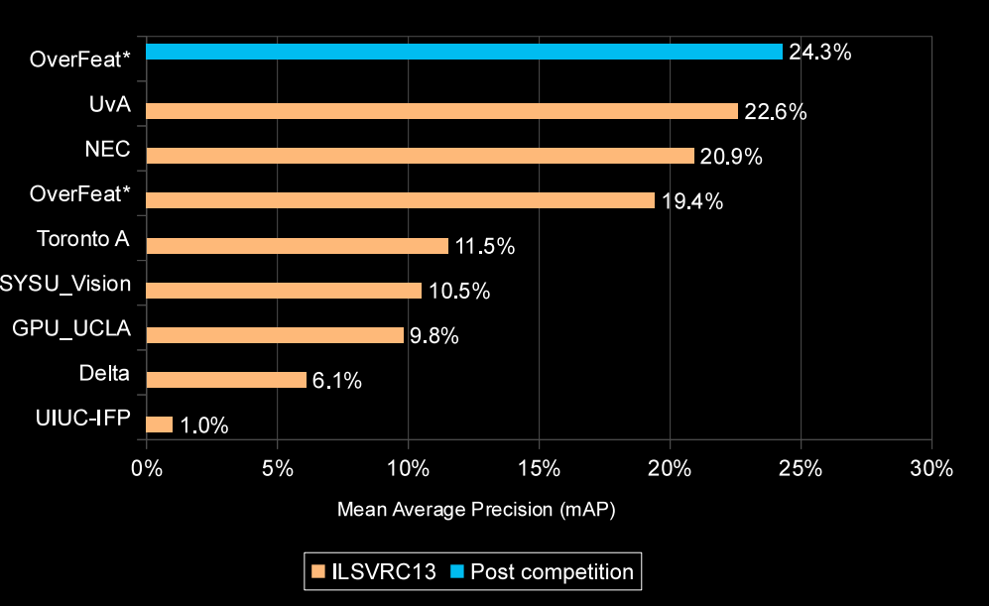
Overfeat - Experiment - Object Detection - Research Paper Result
3rd Rank for Detection task
Paper link: https://arxiv.org/abs/1312.6229

Slide 16
Overfeat - Object Detection - Drawbacks
Background Class
Model
Background Class

Slide 17
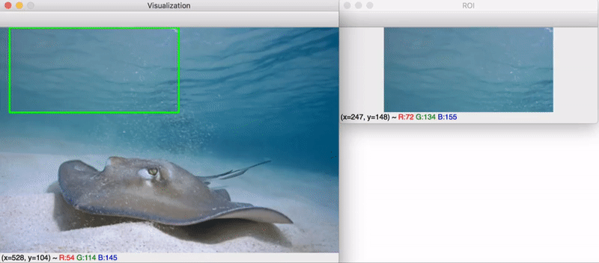
Overfeat - Object Detection - Drawbacks
Each inference takes 2 seconds
Computationally Inefficient and also expensive (2013)
A lot of background region is getting unnecessary processed because of Sliding window or dense Sampling approach
Sliding window approach creates a lot of FP , therefore less MAP
Can we have some way to find to only those regions where background is not present?
Accurate predictions and increase MAP ?
RPNN
END ☺
Credit :https://www.pyimagesearch.com/2020/06/29/opencv-selective-search-for-object-detection/

